Slide 1
When FinOps Meets Cloud Native
How We Reduce Cloud Costs with Cloud Native Scheduling Technologies
Qiming Hu
Jesse Meng

Slide 2


About Us
Jesse Meng
Tencent Cloud Expert Engineer
Qiming Hu
Tencent Cloud Expert Engineer
CNCF ambassador
Co-founder of CNCF landscape project Crane
Author of book "The Keys of Kubernetes Production Adoption”
Translator of book "Cloud FinOps"
Mentor of Cloud Native Campus of geektime
Contributors of Kubernetes, Dapr, KubeFed
Co-founder of CNCF landscape project Crane
Expert of autoscaling, application delivery, multi-cluster management
Translator of book "Cloud FinOps"
Active speaker of conferences, e.g. Kubecon, GIAC, GOTA, Open Infra Days, GDCC, CSDN Columnist etc.

Slide 3

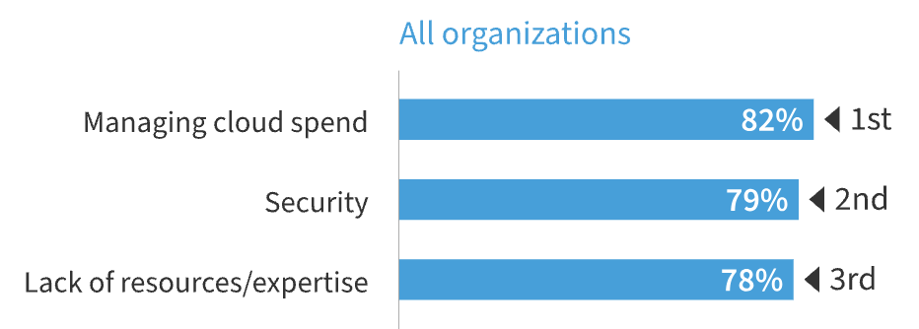


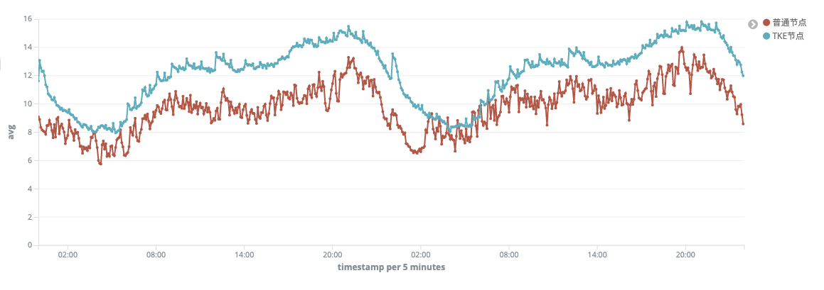
Managing cloud cost becomes the top challenge
External
Internal
More than 90% global organizations will run containerised applications by 2027.
Over 1 million physical servers
50 millions CPU to support in-house apps
Scale
Managing cloud spend becomes top challenge
Challenges
Everything go Cloud (Native)
Average CPU Utilization 10%-31%
CPU Utilization 10%-15% per authorized customers data analysis
Improve Utilization & offboard nodes to save cloud cost
Put offboard nodes to public cloud for commercial Purpose
Objectives
Help cloud users to save cost

Slide 4
FinOps +
Cloud Native
FinOps is an evolving cloud financial management discipline and cultural practice that enables organizations to get maximum business value by helping engineering, finance, technology and business teams to collaborate on data-driven spending decisions.
Inform
Optimize
Operate
Organization Structure Alignment
Rate Optimization
Budget Forecast & Control
Cost Visibility
FinOps
Pricing & Chargeback
Cost Allocation
Usage Optimization
Executives
Unit Cost Optimization
Applications
Platform
Declarative System
Workload Portrait
Quota Management
FinOps
Workload Orientation
Scaling (HPA/VPA/CA)
Cloud Native
Cost Model
Finance
Labels & Annotations
Enhanced Scheduling
Infrastructure As Code
Procurement
Colocation
Unified Observability
Enhanced Scheduling
Budget & Infra Management
Cloud Native increases resource utilization through finer control and automation, reducing FinOps operation costs.

Slide 5
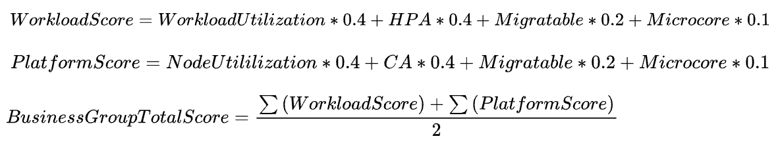
Tencent FinOps Practice - Organization Alignment
Org Structure
FinOps Core Concept：Unit Cost Economics
Technical Community
Cross team Collaboration & Authorization
Executives as Community Members
Cloud Native SIG: Migration Ratio, Maturity, Idle Resource Activation
Department Ownership & Bi-monthly Report
Award & Promotion
Operation Management
Resource Owner & FinOps Participator
Resource Planning & Pricing
Budget Review & Approval
Cloud Native Maturity Model & Scoreboard
Monetization Settlement for Each Business Unit
Flexible Pricing Model for Optimization
Applications
Resource Consumer
Migrating to Kubernetes
Re-architecture to Reduce Pod Size
Rightsizing & Scaling
Migratable & Authorize Platform to Evict Pods as Needed
Platform
Cluster Provider
Unified Resource Pool Management(Idles, Old Gens)
Usage Optimization through Intelligent Scheduling
Maturity Model
Simple & Measurable
Clear Goal Definition & KPIs
Measure Workloads, Products, Departments, Business Groups

Slide 6
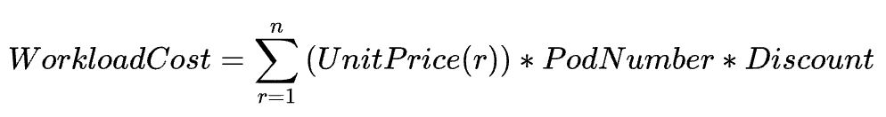
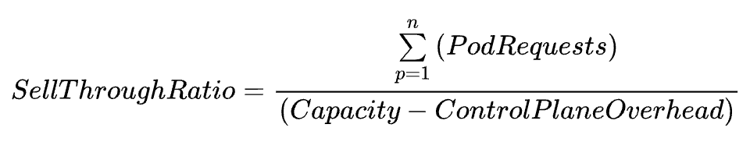
Flexible Cost Model
Use Cheaper
Workloads charged based on unit price, pod count, and runtime
Unit price considers procurement, operation costs, sell-through ratio
Discounts promote team collaboration
Unit Price
Old Gen Discount
Microcore Discount
Old Region Discount
Migratable Discount
Discount
appA
requests:
cpu: 100c
mem: 1Tb
network: 15Gb
GPU: 10
CPU Price：
1c=50/month
+
…
+
…
+
NW Price
1Gb/s=20/month
+
GPU Price
1c=xxxx/month
Unit Price
Based on requests:
capacity：128c
allocatable：150c
requested: 130c
- app A：100c
- app B：30c
…
…
Based on usages:
capacity：10Gb/s
allocatable：20Gb/s
usage: 8Gb/s
- app A：5Gb/s
- app B：3Gb/s
Based on Quota:
appA：10
appB：20
Cost
Allocation
appB
requests:
- cpu: 30c
- mem: 0.5Tb
- network: 5Gb
Nodes
Storages
Load Balancers
CPU
Memory
Disk
Network Bandwidth
GPU
Assets
Application
Requests

Slide 7
Trail Map to Usage Optimization
Use Less
1
Allocate All Resources
2
Utilizes All Resources
3
Local to Global Optimum
4
Resource Supply
5
Requests Optimize
Improve Binpack Ratio
Improve Utilization
Multiple Cluster Scheduling
Machine Recommendation
Workload Optimization
Wastes Identification
Allocation Ratio
Dashboard
Resource Over Commit Dashboard
Cross Cluster Offer vs Req
Dashboard
Machine Offering vs Req
Dashboard
Extreme Resource Request
Dashboard
Optimization Capabilities
Scheduling Policy Opt (Binpacking)
Load aware Scheduling
Cross Cluster Scheduling
Machine Recommendation
Res Recommendation
Offline replay & Reschedule
Load aware Rescheduling
Cross Cluster Rescheduling
Cost Optimized CA
Memory Offload
Migratable Ratio Improvement
Low Utilized Node Capacity Enlarge
Idle Resources offboard
Colocation
Asset Onboard/Offboard
Asset Procurement &
Waste Resource Activation
Maturity Review & Budget & Quota Approval
Cost Forecasting & Budgeting

Slide 8
Allocation Ratio Improvement
Challenges
Theoretical limit for multi-dimensional resource packing is hard to evaluate
Scheduling based on independent random events
Balancing scheduling latency vs. optimal results
Heterogeneous hardware and requests
Technical Solutions
Optimization of scheduling strategy (Kubernetes supports Best-Fit strategy):
LeastAllocated: Default
MostAllocated: Focus on CPU & Memory
Requested2CapacityRatio: Increase GPU weight
Optimization of scheduling capabilities:
Consider affinity, prioritize critical affinities (e.g., cross-regional), and reduce others
Match requests with machine types
Concentrate deployment of non-migratable Pods
Overcommit allocatable resources for low utilized node
Notes:
+云徙系统
+如何提升业务的可调度性
如何持续腾挪
如何挖掘差异化sla业务
如何加固稳定性

Slide 9
Workload Migratable is matter
Challenges
Workloads scaling with actual load
drain nodes and scale down cluster to reduce idle cost
Many Scenarios:
Holiday Spike Scaling, Daily Cluster Defragmentation, Asset Offboarding
Offline Inspect:
Rebalance nodes to identify utilization hotspots
Technical Solutions
User Transparent Live Migration
Daily Rebuild for Migratable Workloads in Off-Peak Hours
Reorder requests, find better placement
Rebuild pods
Scale down nodes to CA pools
PDB is the contract of Platform and Application
Approval Workflow for Non-Migratable Workloads (e.g., stateful, long connection)
Offline Re-scheduler
Reorder Requests
Rebuild Pods
Scale Down Nodes
BG A
BG B
Cluster A
Cluster 2
Cluster 3
Result: Global Allocation Ratio 95%
CA Pool: Shared by all Business Group, Price 50% off
CA Pool of Region A
Notes:
重调度合并到这里
春保、日常扩缩容、公有云上量让出、裁撤
结构不是很清楚，讲调度能力建设不是分业务
整体腾挪能力如何？ 腾挪效果如何？带来了成本如何？
资源测算、腾挪检查、逐步腾挪、xxxx

Slide 10
Utilization Improvement
Challenges
Kubernetes scheduling based on user-declared requests
Oversizing leads to waste
Scheduling unaware of actual load, causing node load imbalance
Technical Solutions
Predict resource requests using historical metrics; build resource portraits
Multiple algorithms: DSP, Moving Window, Transformer
Multiple dimensions: Resources & Business Metrics
Workload Resource Recommendation
Request/Replicas/HPA
Load-aware Scheduling/De-scheduling
Introduce scheduling and de-scheduling thresholds
Schedule pods when actual load is below scheduling threshold
Evict pods when de-scheduling threshold is reached
Result: online cluster CPU utilization 48%, node load variance is lower than 10%
Notes:
内部碎片 -利用率峰值

Slide 11
Differentiated SLA Colocation
Challenges
Launch batch jobs to consume off-peak hour idle resources
Introduce low SLA workloads for higher resource contention
Technical solutions
Reclaim idle resources
Enable Cloud Native FaaS platform
Dig near-line workload to consume reclaim resources
Isolate nearline resource consumption from online (e.g. cpusets)
Interference Detection and Avoidance(e.g. pod evictions)
Result: Colocation Cluster CPU Utilization 65%
Event Triggers
FaaS Schedulers
Kubernetes Clusters – Dynamical Reclaim resource pools
Requests
Pod
Online K8S Cluster
Threshold Mgmt
App Portrait
Idle Res Reclaim
CKafka
Req Queue
Pod
Pulsar
Resource Aware
Scaling Predict
Resource Supply
Pod
Online K8S Cluster
Route
Idle resource
reclaim
Reservation
Cloud Object Storage
Pod
Resource Predict
Resource Isolation
Monitoring
Nearline Tasks
MPS
Pod
Online K8S Cluster
Priority Mgmt
Enhanced Schedule
Conflict Handling
Res Scheduling
...
Timer
Backup resource for rescheduling
Resource Mgmt
Res Schedule
Res Ensurance
Instance Mgmt
RPS
Instance Recycle
Backup FaaS resource pool
... ...
Quota
SCF Inst
SCF Inst
SCF Inst
SCF Inst
…
…
…
SCF Inst
SCF Inst
SCF Inst
Notes:
多优先级混部

Slide 12
We tended to sharing our knowledges and technical expertises with the community for the common good.
And Crane is the Answer

Slide 13

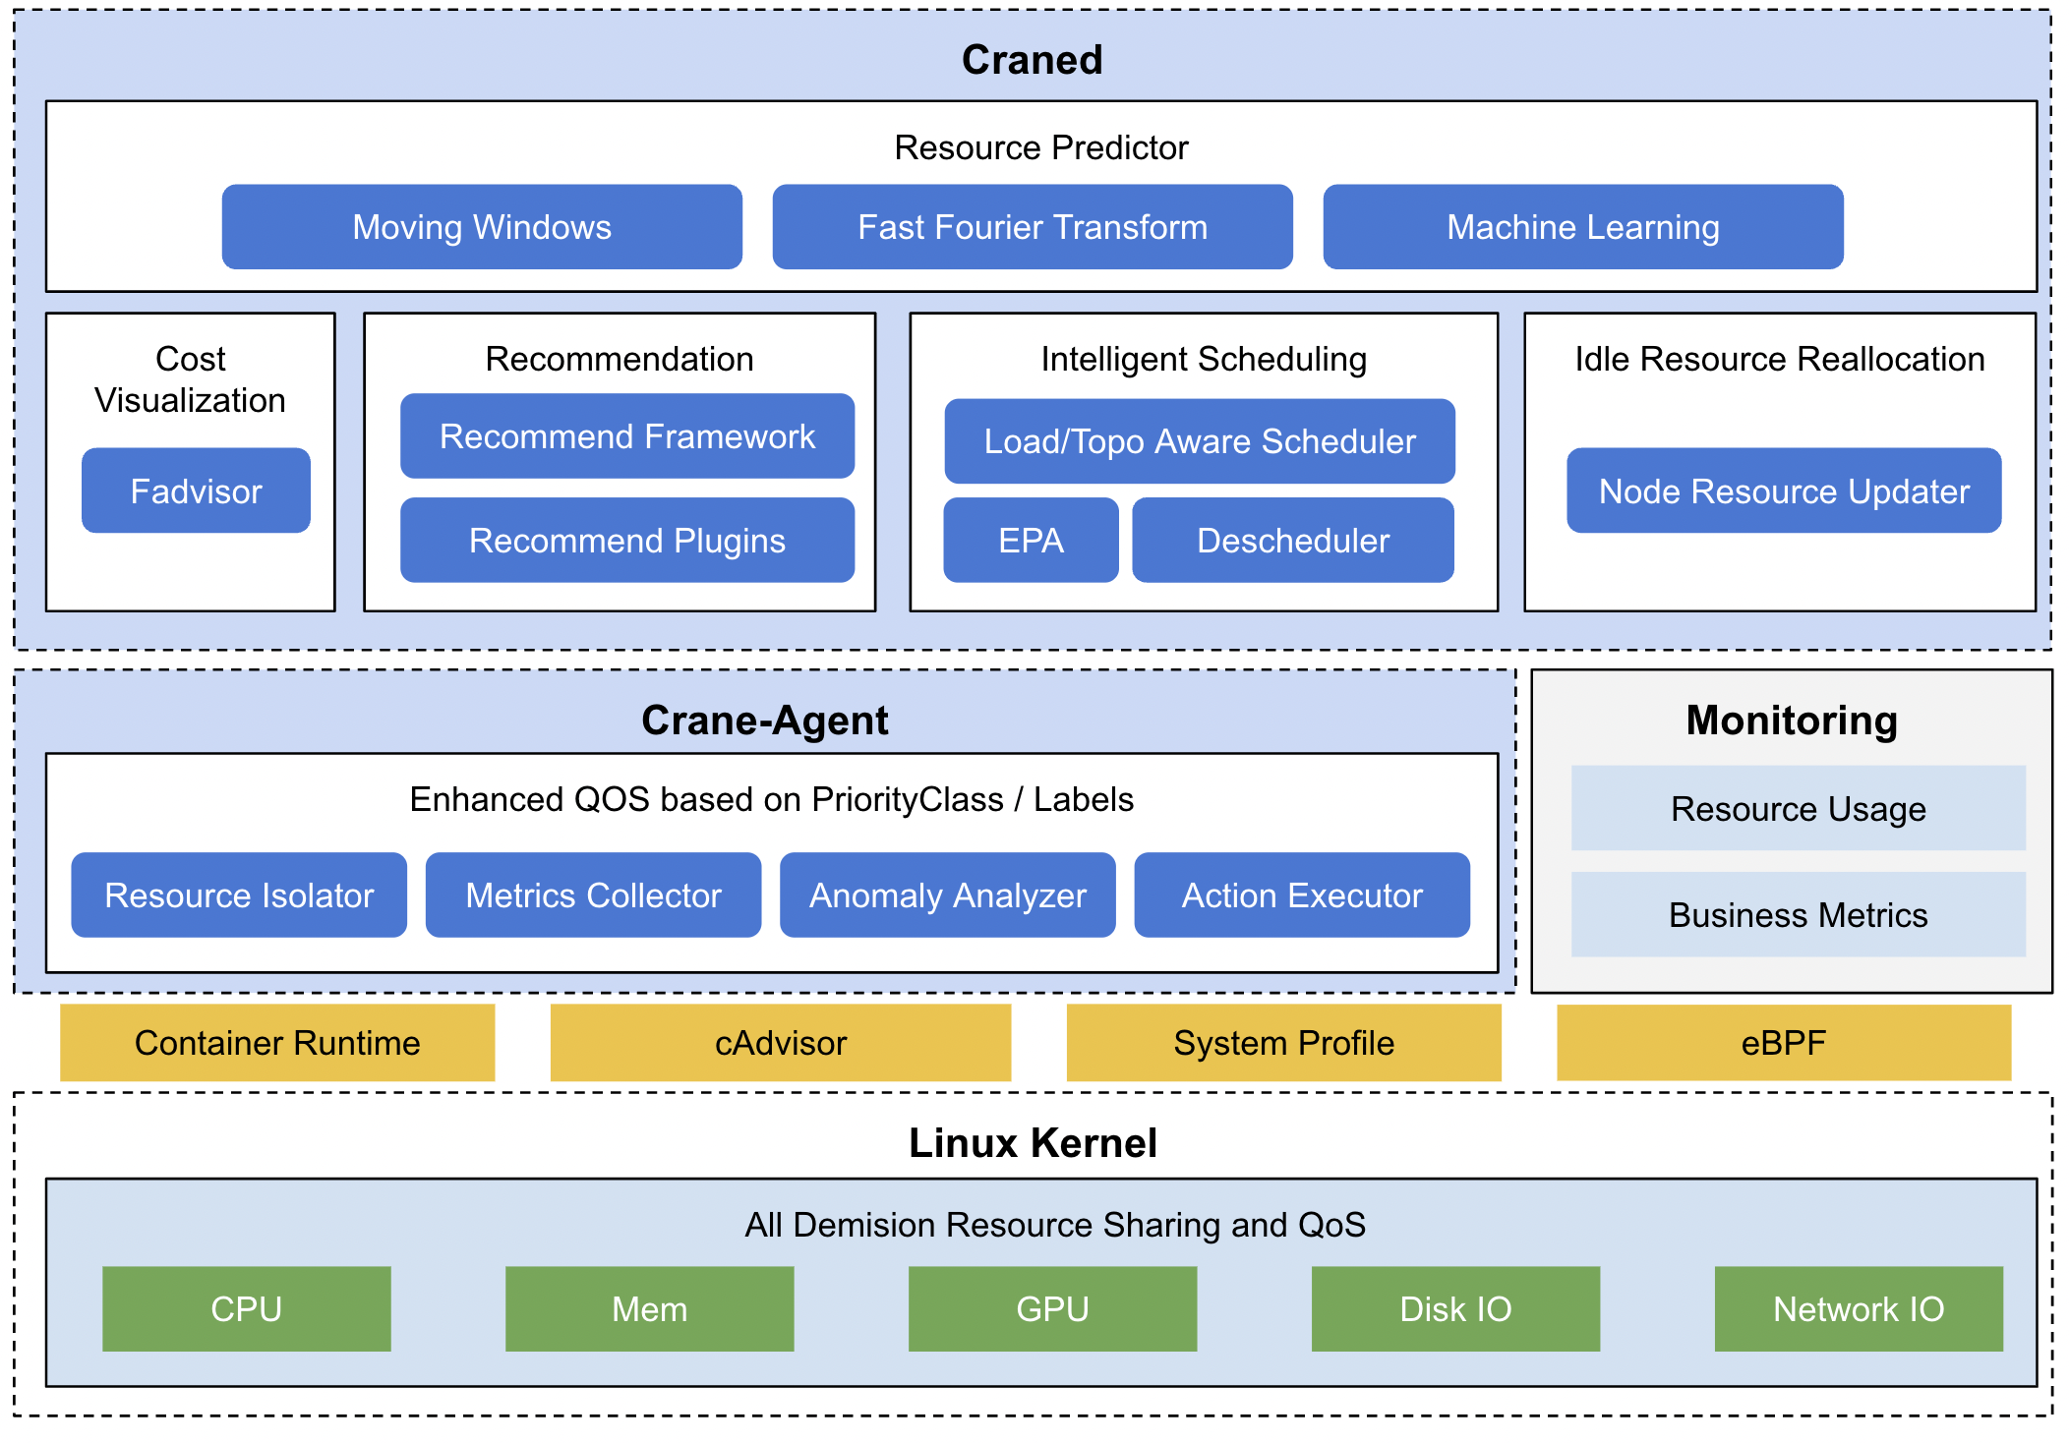

Crane: Cloud Resource Analytics and Economics
https://github.com/gocrane/crane
Crane is a FinOps Platform for Cloud Resource Analytics and Economics in Kubernetes clusters
Crane is the FIRST open-sourced FinOps Foundation Certificated solution.
Crane won STATE AWARDS:
2022 Cloud Computing Center Technology Award of China Electronics Technology Energy Conservation Association
2023 Outstanding Project Award for Leading Technology Achievement of China International Big Data Expo

Slide 14
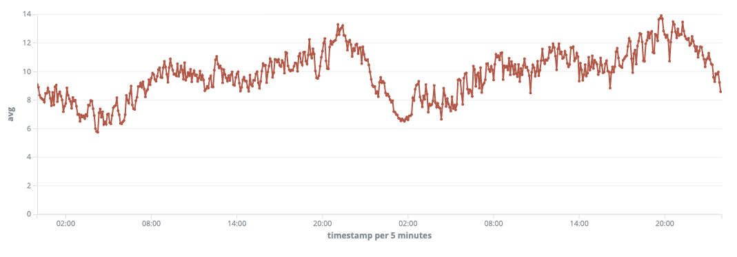
Case1: Background
Total CPU Usage is 10%, wasted too much

Slide 15
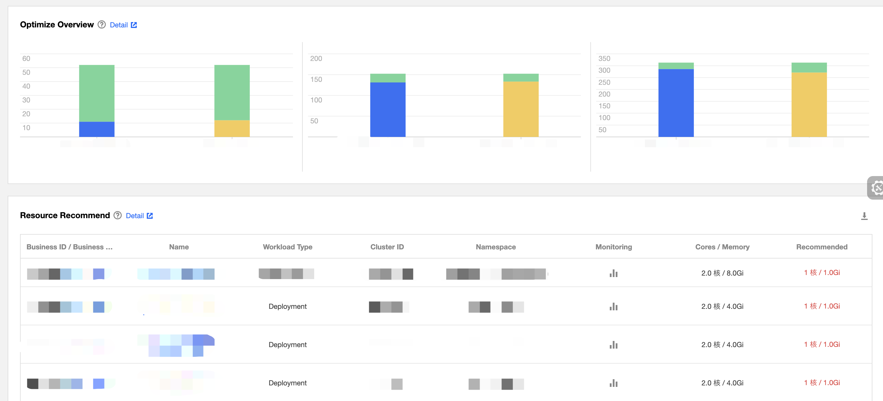
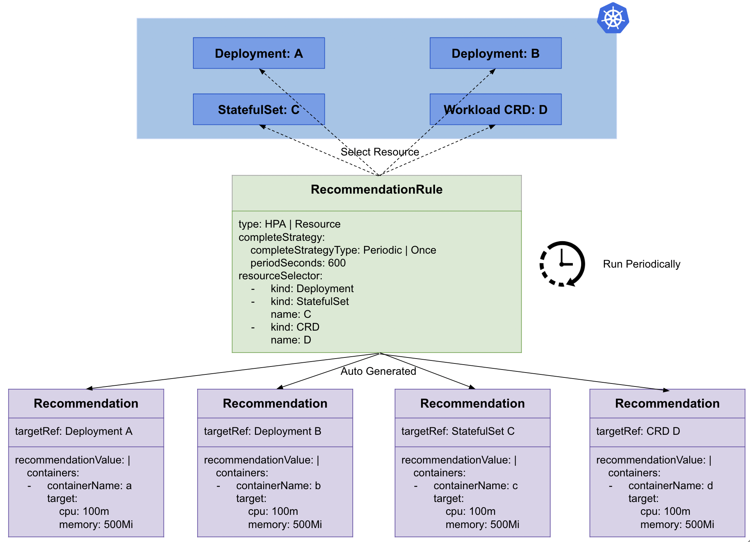
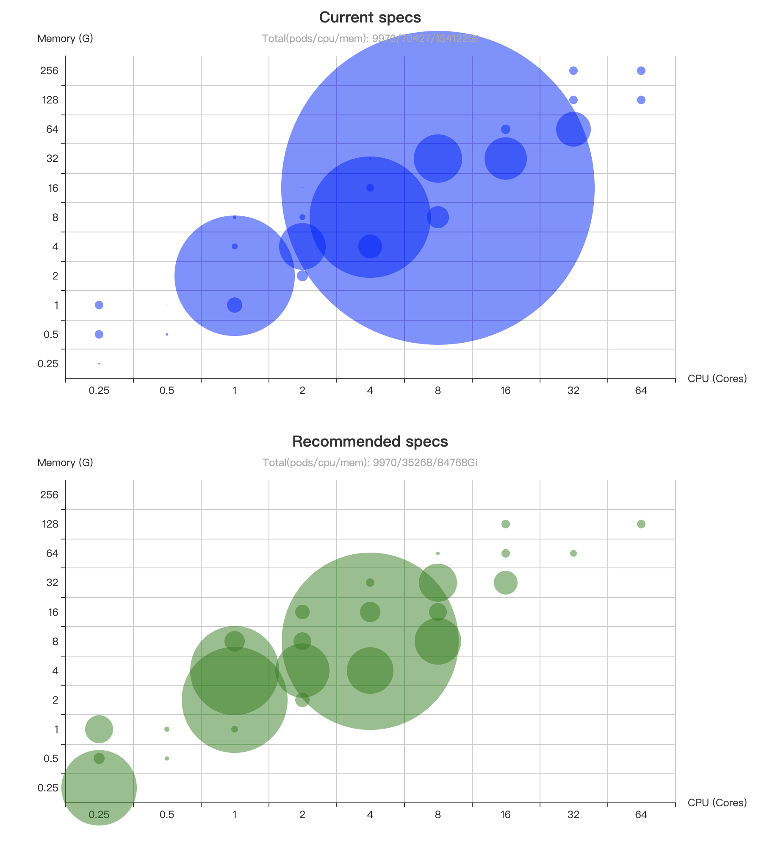
Case1: Request Optimization
Declarable
Provide recommended values for specified namespaces and workloads.
Configurable algorithms
Dynamic recommendation scenarios：Exponential bucket + half-life
Static recommendation：balanced bucket+ Margin or Target Utilization rate.
步骤一：通过控制台点击完成滚动升级
Kubernetes Cluster
Metrics
Recommendation
Github:
Deployment specs
Workload
规格推荐成果
CICD
Argo/Zadig
步骤二：成本左移与自动化

Slide 16
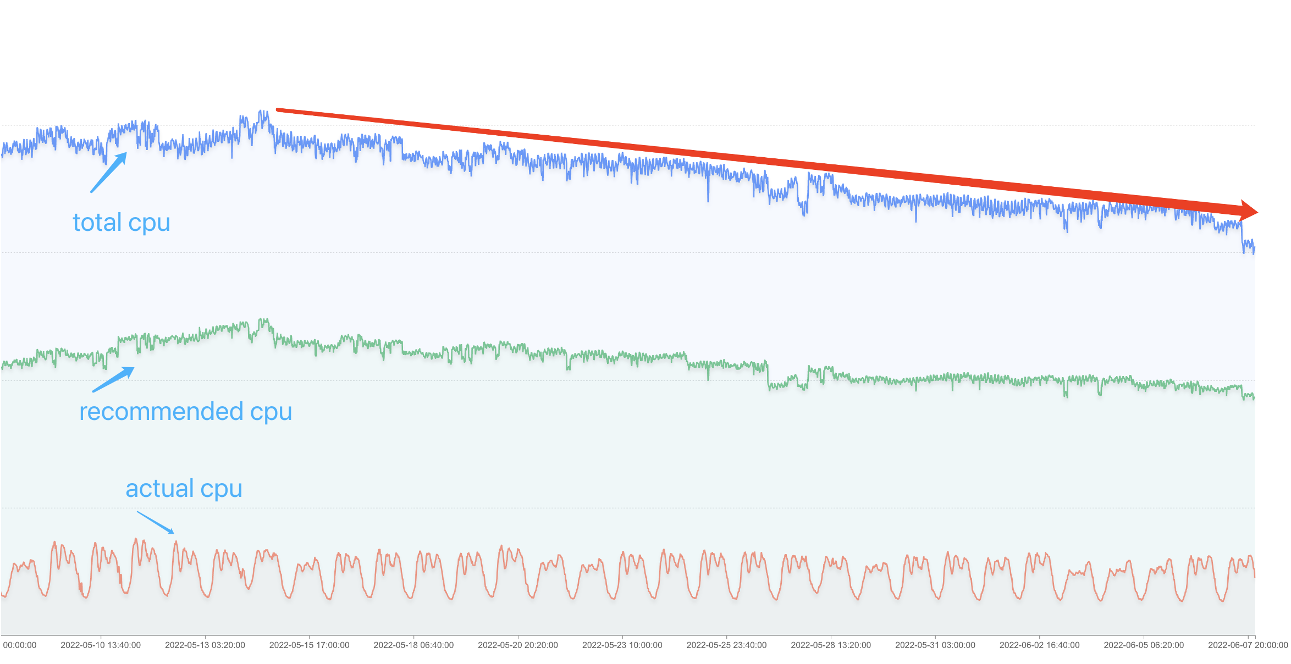
Case1: Achievement
The total number of Cores in clusters were reduced by 25%.

Slide 17
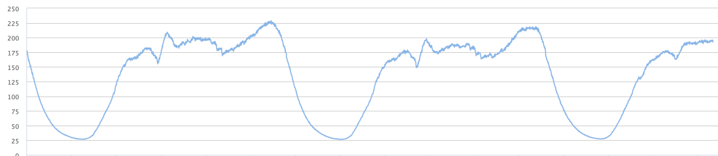
Case2: Background
The business traffic has Cyclical characteristics
Workload can scale Horizontally
Running on the Cloud

Slide 18
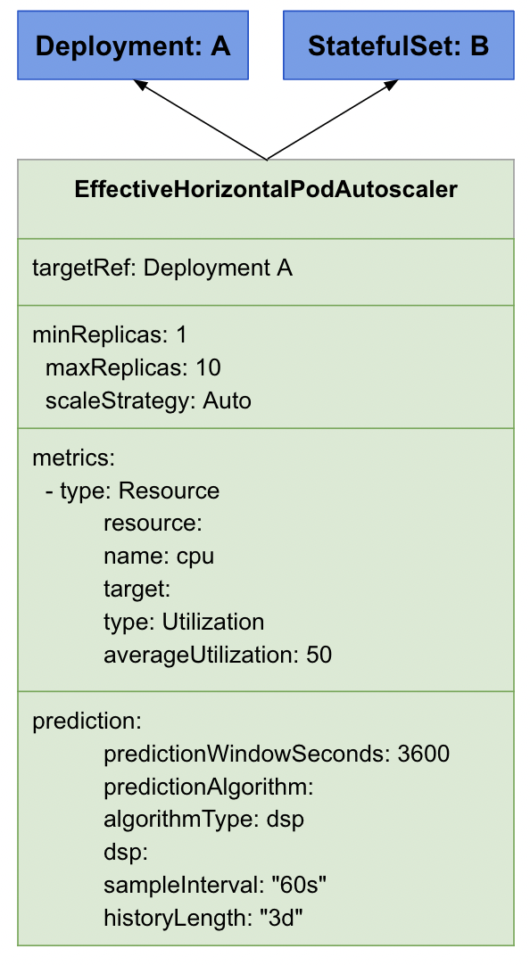
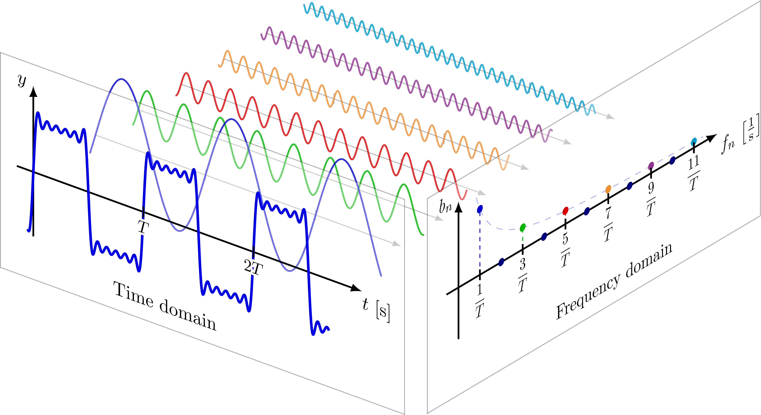
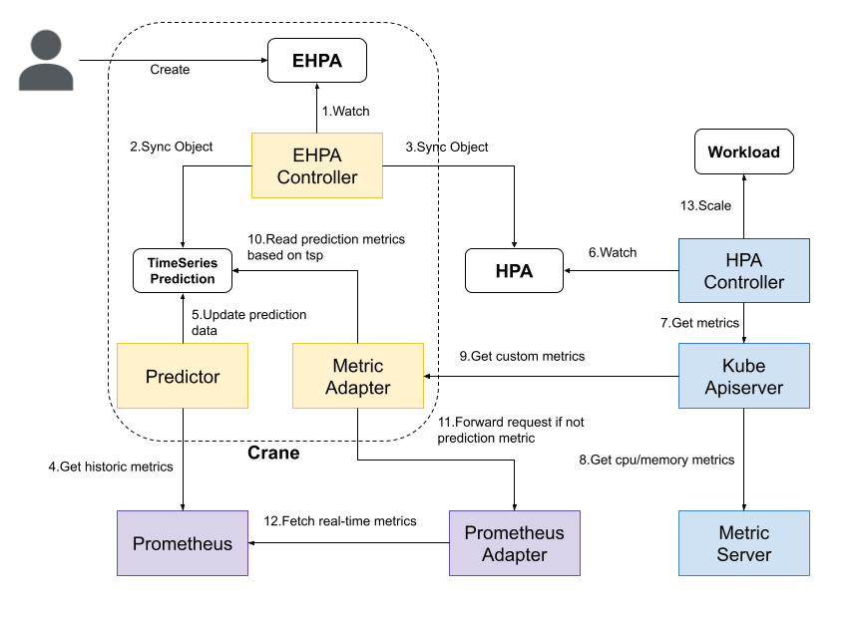
Case2: Effective HPA
Prediction-driven
Timeseries Algorithm：FFT Fast Fourier Transform
Scale up before incoming peak
Based on Custom Metric
Fallback protection
Reduce unnecessary downsizing
Forecast future to reduce unnecessary downsizing
Cron-based scaling
Regular traffic peaks during holidays and promotions.
Easy to use
Full compatible with community HPA
Supports Dry run
Supports Prometheus Metric

Slide 19
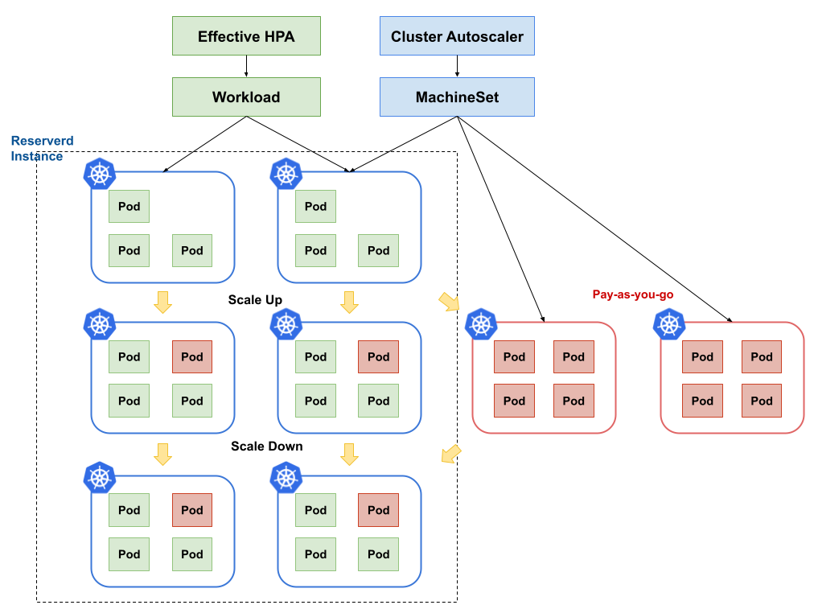
Case2: Cluster Autoscaler
Effective HPA
Scaling based on CPU and Network Traffic
Upsizing one hour before the traffic peak arrives
Newly created pods trigger cluster expansion
Cluster Autoscaler
Scale out Pay-as-you-go nodes Based on pending pods
Scale in Pay-as-you-go nodes when traffic goes

Slide 20
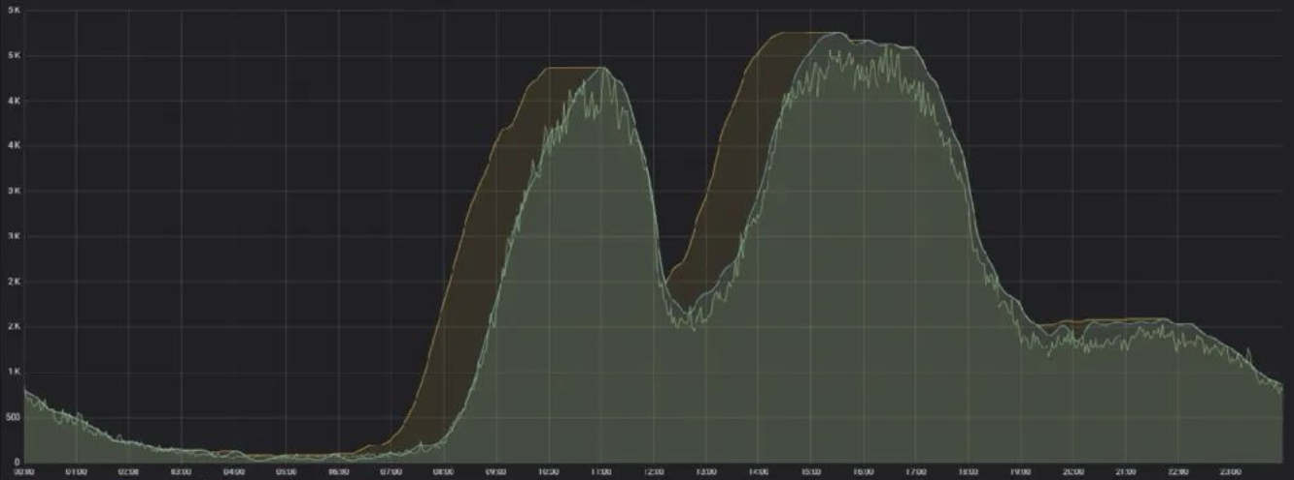
Case2: Achievement
During peak hours, the Node Utilization Rate can reach 70%.

Slide 21
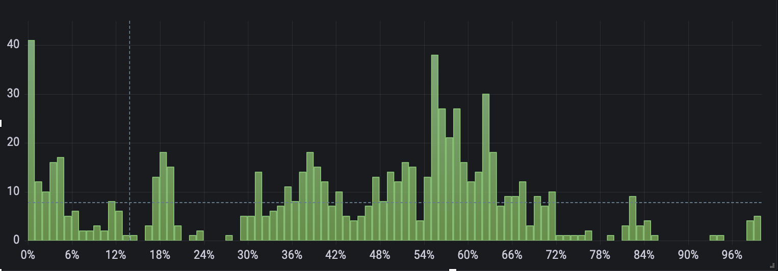
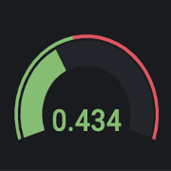
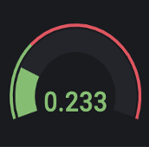
Case3: Background
There are Resource Fragments in the node resources, which affects the further improvement of the packing rate.
Node load Imbalances affects application stability.
Cluster Node CPU Load Distribution
Average
Standard Deviation

Slide 22
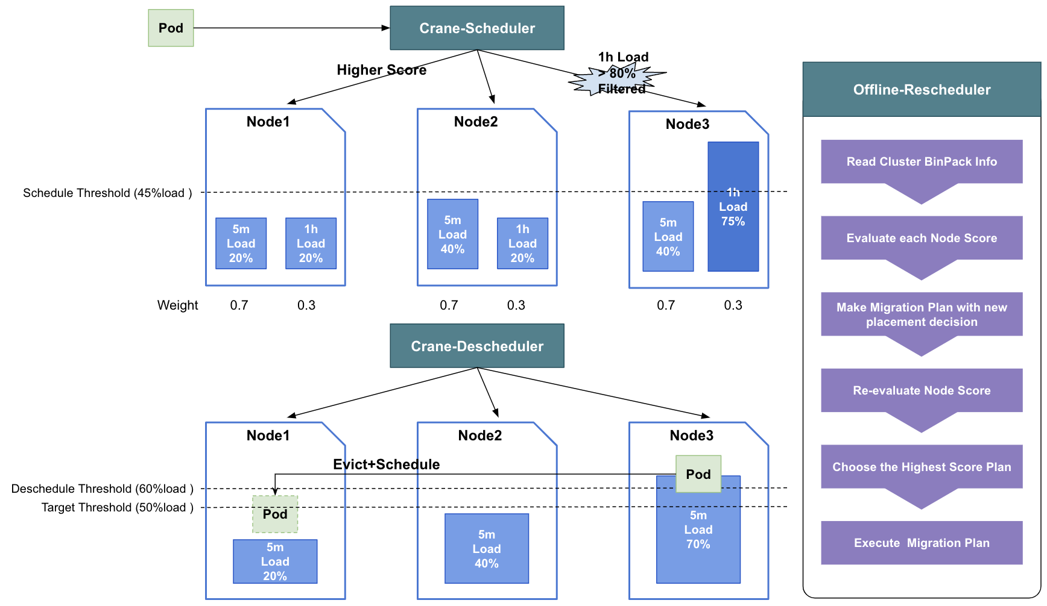
Case3: De/Scheduler + Auto relocation
Scheduler
Load-Aware Scheduling
Use the Node Load to replace the request
Introduce node historical load metrics(1h,1d) to perceive business peak
Descheduler
Rebalance pods based on Node Load
Evict pods from High Load nodes and schedule to Low Load nodes
Use Reschedule Threshold and Target Threshold to control the process
Offline-reschedule
Re-evaluate each node bin pack score
Pick up low score node and make new scheduling plan
Execute migration plan and offboard empty nodes

Slide 23
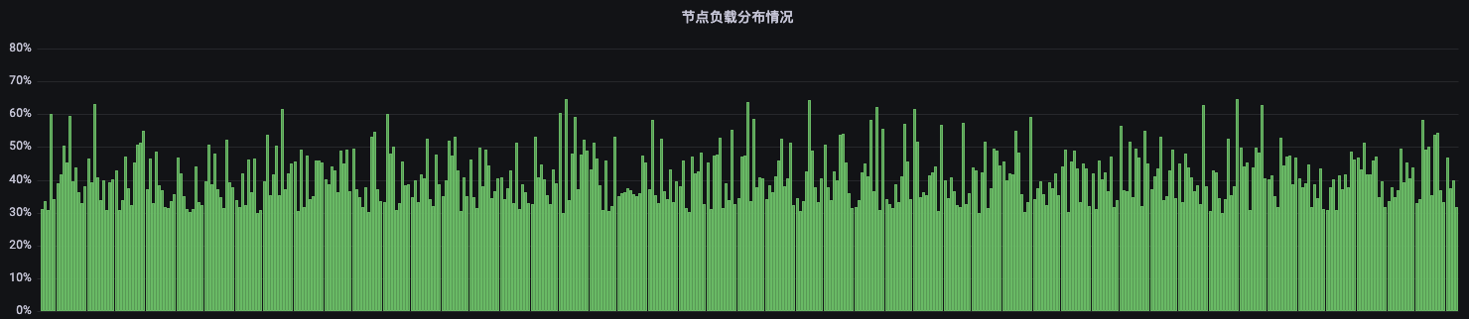
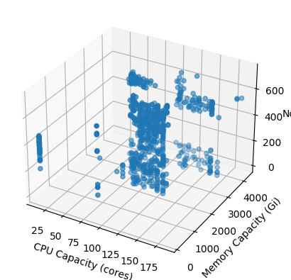
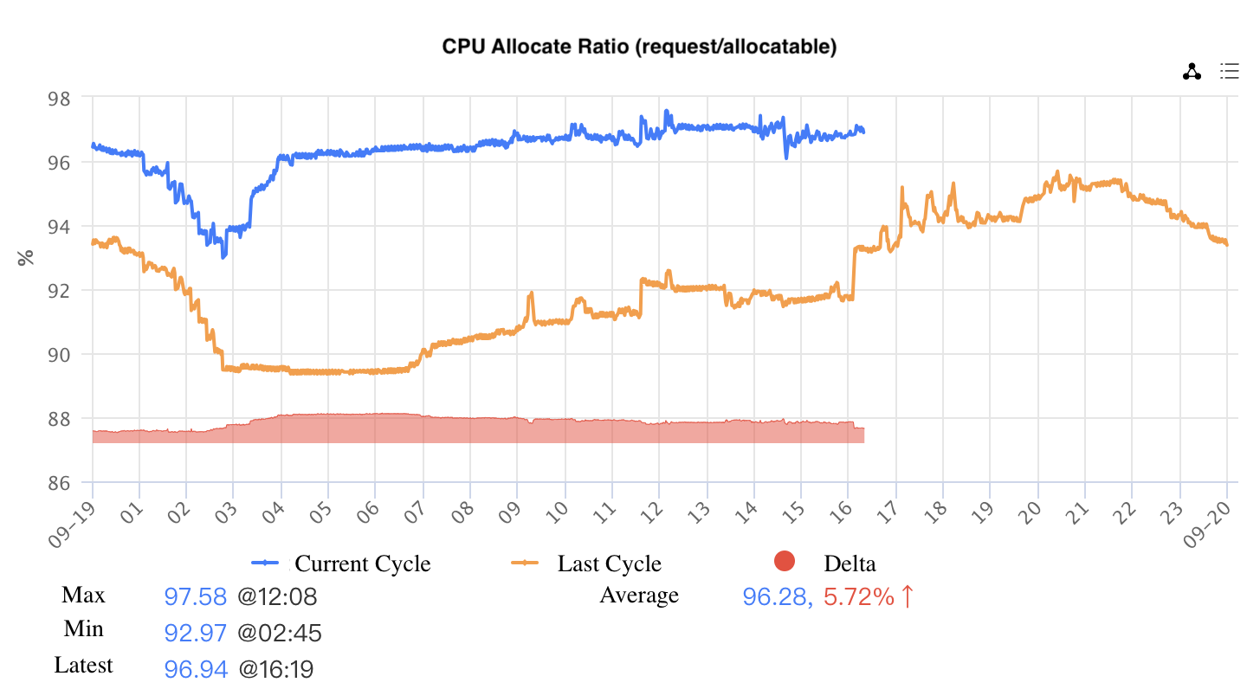
Case3: Achievement
Online cluster CPU Utilization 48%, Node Load Variance is lower than 10%
CPU Allocated Ratio (Request / Allocatable) > 95% in all heterogeneous clusters

Slide 24







Adoptions
Tencent Production Adoptions
Open Source Community Adoptions
In-house Clusters
Crane becomes the unified scheduling component
Deploy as a cluster baseline feature, and managing 17 millions cores, online cluster CPU utilization 48%
Reclaims 7millions idle CPU resources and consumed by near-line applications via FaaS platform, colocation cluster CPU utilization 65%
Public Cloud Offerings
Crane enables Tencent Public Cloud products
TKE Super Node – Recommendation & EHPA
TKE Native Node – Scheduling & Colocation
TKE Distributed Cloud Center – Cost Insight & Scheduling

Slide 25
Future Plan
Intelligent Scheduling based on AI/ML
Long-Short Term Resource Prediction Based on Deep Transformer
Node resource amplification
Integration of recommendation framework with CICD platform such as ArgoCD, Jenkins

Slide 26
Q&A
More Information
Official Website: http://gocrane.io
Github Repo: https://github.com/gocrane/crane

